Slide 1
Tracking and Pose Estimation of a Robotic System using Computer Vision
By: Karl Spiteri
Course: Bachelor of Engineering (Honours) in
Control and Electronics Engineering
Mentor: Dr Ing. Jeremy Scerri
1

Slide 2
Literature
Tracking Techniques in Computer Vision
Traditional Tracking Approaches
Kalman Filters
Particle Filters
Deep Learning-based Tracking Techniques
Single Shot Detectors (SSDs)
You Only Look Once (YOLO)
Computer Vision Marker Based Pose Estimation in Robotics
Marker Systems & Calibration Techniques
Calibration Benefits
ARTag, AprilTag, ArUco, and Stag
Comparative Review of Kinematic Models in Robotics
Forward Kinematics
Inverse Kinematics
Denavit-Hartenberg Parameters
2
Notes:
Discuss the current state of computer vision techniques in robotics.
Highlight the importance of real-time object tracking and joint angle measurement.
Discuss the significance of a live skeleton view of the robotic arm.

Slide 3
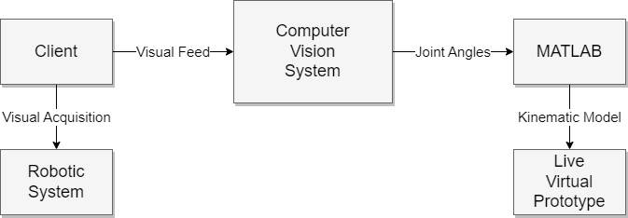
Block diagram
3

Slide 4

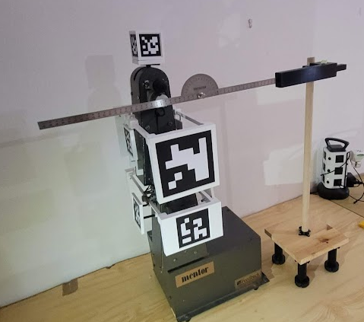
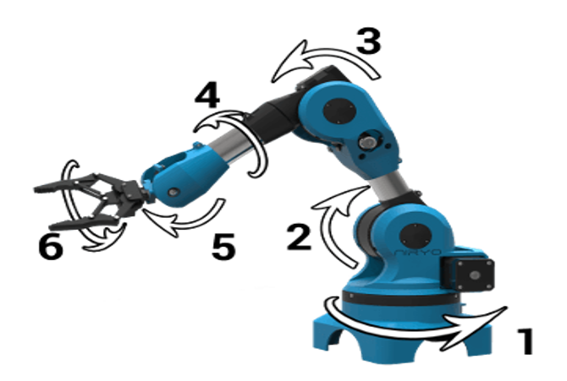
Objectives
The objective of the system is to track a robotic arm and estimate its pose data.
No control algorithm is utilized within the system.
Advantages of ArUco Markers with Encoders
External Reference
Failure Detection
4
Notes:
Discuss the main objectives of your thesis.
Mention related topics that are not directly objectives of your research.
External Reference: Encoders provide internal measurements of the joint angles, but they don't provide any information about the absolute position and orientation of the robot in the world. Aruco markers, on the other hand, can provide an external reference that allows you to determine the absolute pose of the robot.
Drift Compensation: Over time, small errors in the encoders' measurements can accumulate, leading to significant drift in the estimated pose of the robot. By using Aruco markers, you can correct for this drift and maintain accurate pose estimation over longer periods of time.
Failure Detection: If an encoder fails or provides incorrect readings due to a mechanical issue, the error might not be immediately obvious. By comparing the pose estimation from the encoders with the pose estimation from the Aruco markers, you can detect such failures more quickly.
Flexibility: Aruco markers can be placed anywhere in the robot's environment, allowing you to track the pose of the robot relative to any point of interest. This can be useful in applications where the robot needs to interact with different objects or areas in its environment.
Simplicity: While encoders require physical integration into the robot's joints and often require careful calibration, Aruco markers can be used with a simple camera and image processing software. This can make them easier to set up and use in some cases.
Cost: Cameras can be relatively inexpensive compared to high-precision encoders, making Aruco markers a cost-effective solution for pose estimation in some cases.
Multi-robot Systems: In scenarios where multiple robots are working in the same space, each robot equipped with a camera can use the Aruco markers to estimate not only its own pose but also the pose of the other robots. This can be beneficial for coordinating the movements of multiple robots.
Non-Invasive: Aruco markers can be used to estimate the pose of objects in the environment without needing to physically modify those objects. This can be useful in scenarios where the robot needs to interact with objects that cannot or should not be modified, such as delicate or valuable items.
Summary:
External Reference: Aruco markers provide absolute pose information relative to the external world, unlike internal joint angle measurements from encoders.
Drift Compensation: Aruco markers can correct drift errors that accumulate over time in encoder measurements.
Failure Detection: Comparing encoder and Aruco marker estimations can help detect encoder failures or inconsistencies.
Flexibility: Aruco markers can be placed anywhere, enabling pose tracking relative to any point of interest.
Simplicity: Aruco markers, used with a camera and image processing software, are often easier to set up and calibrate than encoders.
Cost: Cameras can be less expensive than high-precision encoders, making Aruco markers a cost-effective pose estimation solution.
Multi-robot Systems: Aruco markers allow robots equipped with cameras to estimate the pose of other robots in the same environment.
Non-Invasive: Aruco markers enable pose estimation of objects without physical modification, ideal for handling delicate or valuable items.

Slide 5
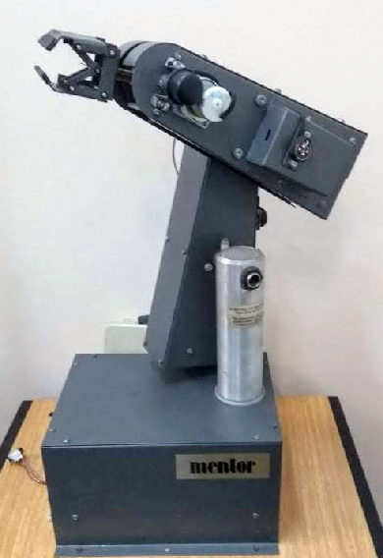
Justifications
Robotic arm was chosen for industry-standard relevance.
ArUco markers were chosen for their robustness and occlusion handling capabilities, making them a popular choice for fiducial markers.
WebSocket was preferred over Raspberry Pi due to performance improvement and cost-effective distribution among multiple clients and vision systems.
5
Notes:
Explain why you chose a robotic arm for this project.
Justify the use of ArUco markers in your project.
Discuss why you decided not to use a pi in the vision system.

Slide 6
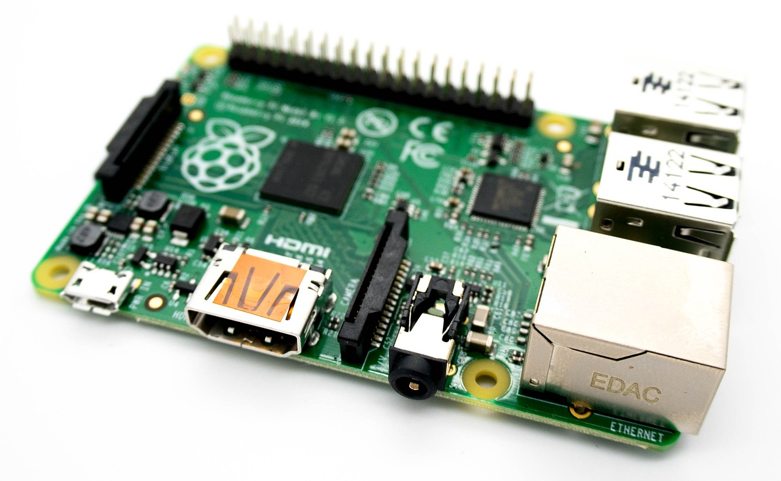
Change
Performance with pi
Less than one fps approx. 0.2 fps
More complexity for implementation
Expensive for expanding
Performance with WebSocket
Minimal performance hit
Minimal complexity for implementation
More flexibility for expanding
6
Notes:
Discuss the results of the CAD designs testing.
Highlight the importance of marker placement and design.
Discuss the significance of end effector marker placement.

Slide 7
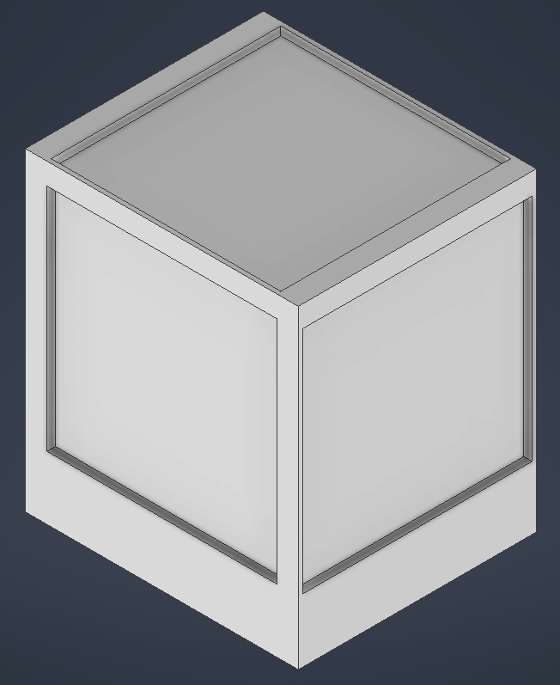
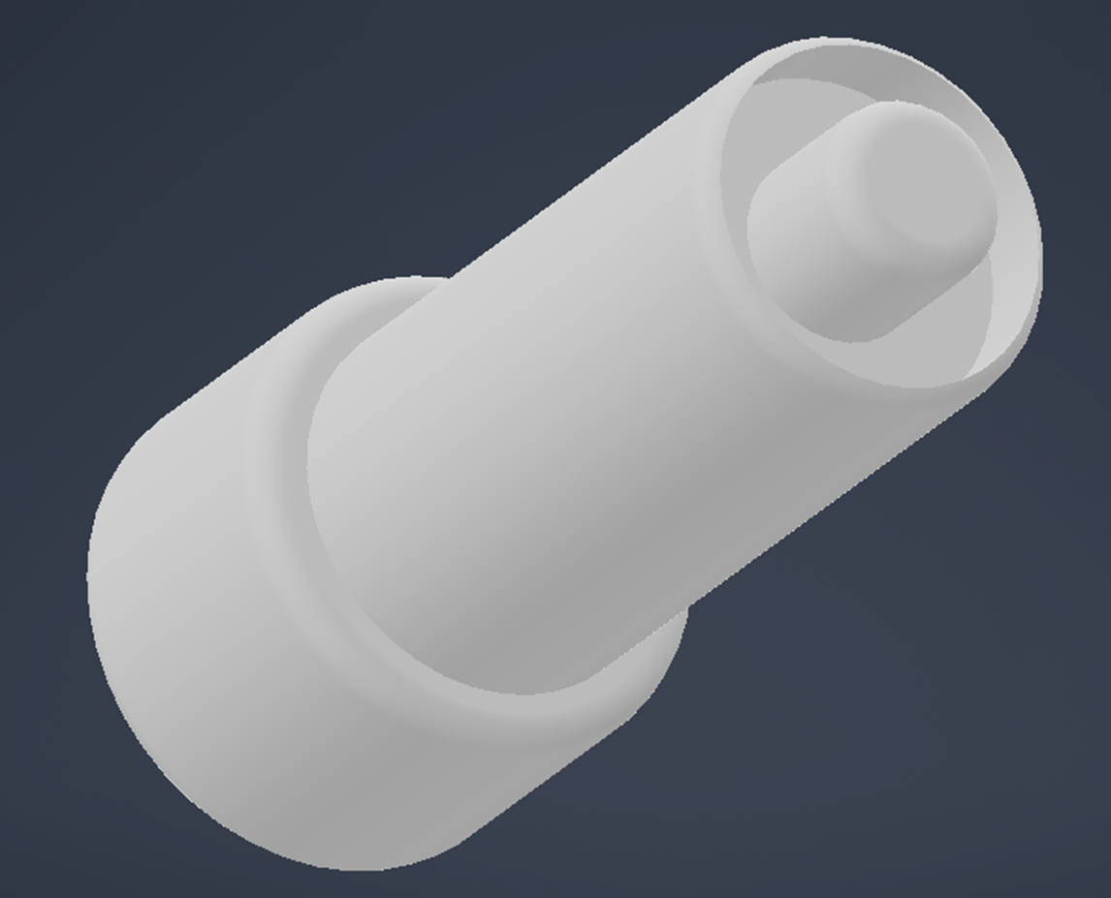
CAD Augmentation
Modular designs implemented for precise marker positioning near the joints.
Augmentation was needed for placements of markers; this was done with tailor made 3D printed CAD.
7
Notes:
https://cdn.pixabay.com/photo/2014/12/18/13/53/raspberry-pi-572481_1280.jpg

Slide 8
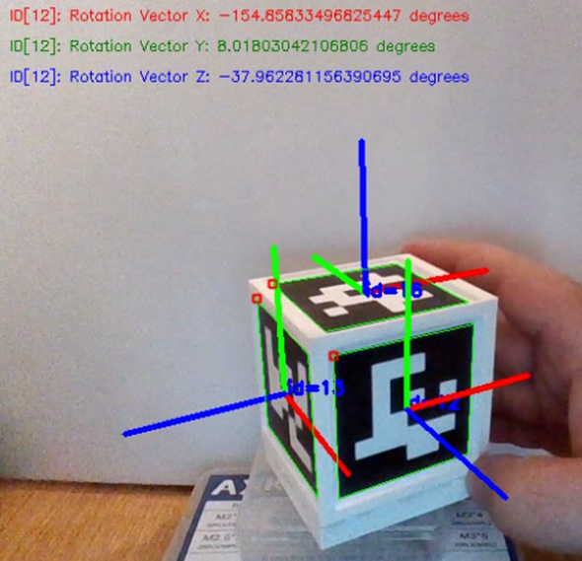
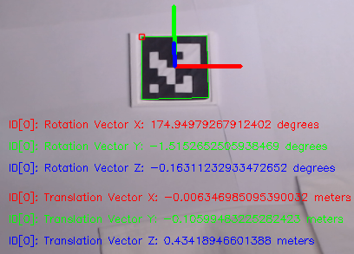
ArUco Markers
The Accuracy depends on:
Camera quality impacts pose estimation accuracy by capturing more detail.
Larger markers with higher resolutions are more easily detected, especially at greater distances.
Posture assessment accuracy decreases with markers that are distant or at oblique angles.
8
Notes:
Discuss the process of generating markers. -> A python script was employed to generate accurately sized markers with the required IDs.
Highlight the importance of camera calibration. -> Camera calibration is important for accurate measurement and estimation of camera parameters, enabling precise mapping of real-world coordinates to image coordinates.
Discuss the process and results of ArUco Marker Data Extraction. -> The system checks each frame for ArUco markers from a 6x6 dictionary and utilizes the camera calibration matrix to obtain the rotational and translational matrices of each marker relative to the camera, meaning that the camera is established as the world reference frame.

Slide 9
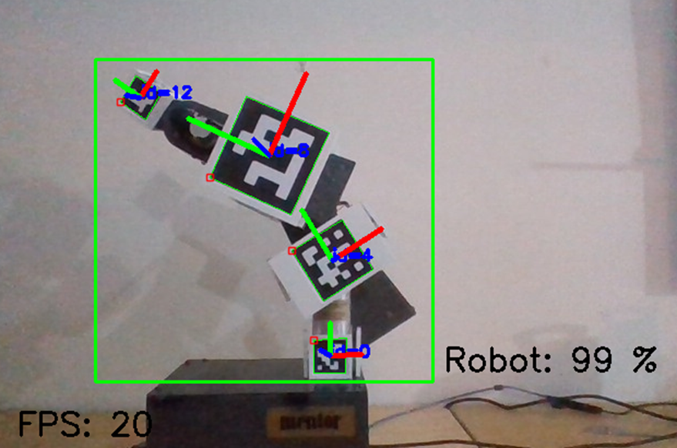
Tracking
High accuracy in identifying and localizing the robotic system.
Precise classification.
Real-time processing speed.
9
Notes:
https://cdn.pixabay.com/photo/2014/12/18/13/53/raspberry-pi-572481_1280.jpg

Slide 10
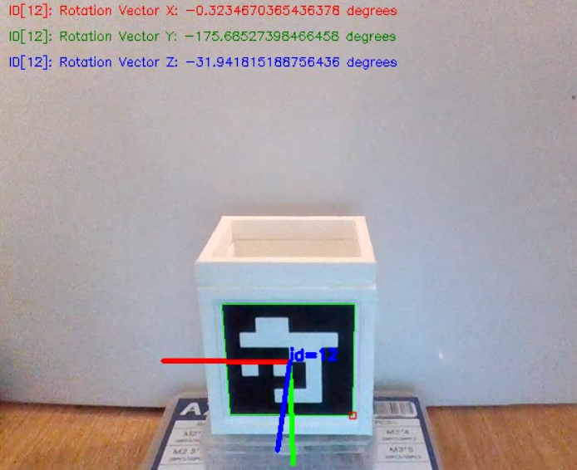

ArUco Results at $0°$
Rotational Matrix
Rotational Vectors
ID & Corner Detections
3D-Axis
10
Notes:
Discuss the results of the CAD designs testing.
Highlight the importance of marker placement and design.
Discuss the significance of end effector marker placement.

Slide 11
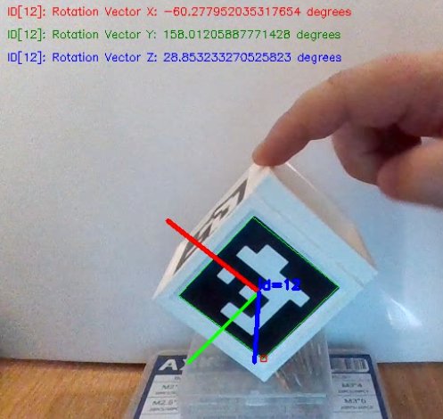

ArUco Results at $≈60°$
Rotational Matrix
Rotational Vectors
ID & Corner Detections
3D-Axis
11
Notes:
https://cdn.pixabay.com/photo/2014/12/18/13/53/raspberry-pi-572481_1280.jpg

Slide 12
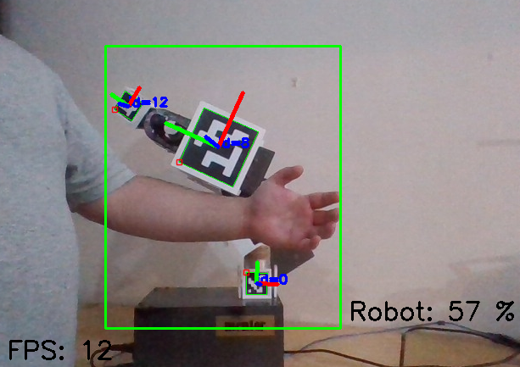
Occlusion Results
Partial Occlusion Recognition
Feature Generalization
Effective
12
Notes:
Discuss the results of the CAD designs testing.
Highlight the importance of marker placement and design.
Discuss the significance of end effector marker placement.

Slide 13
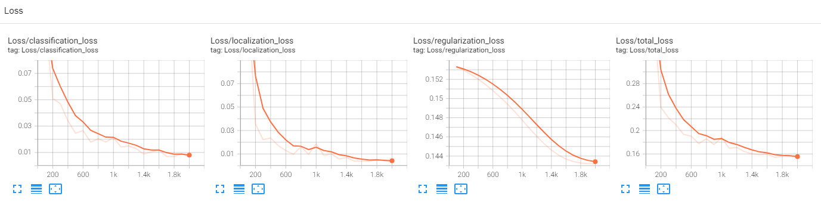
Loss results
Types of loss
Classification
Label
Localization
Boundary
Regularization
Simplify/Generalize
Total
All together
13
Notes:
https://cdn.pixabay.com/photo/2014/12/18/13/53/raspberry-pi-572481_1280.jpg

Slide 14
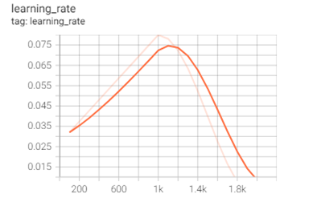
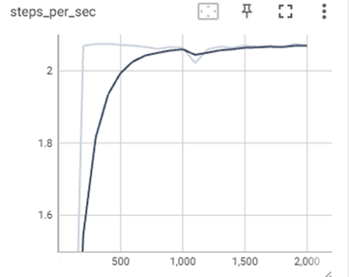
Learning Results
Learning Rate
Efficiency Improvement
Resource Savings
Efficiency of each step
Stable
Consistent
14
Notes:
Discuss the results of the CAD designs testing.
Highlight the importance of marker placement and design.
Discuss the significance of end effector marker placement.

Slide 15
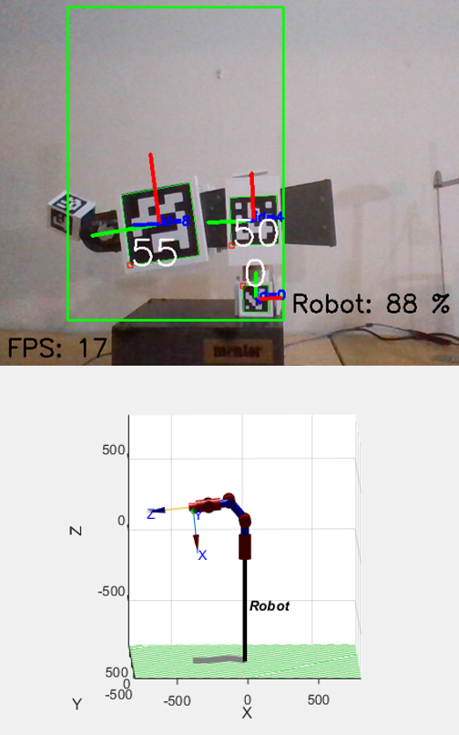
Achieved Results
The project's potential has been shown by
The tracking of the robotic arm,
Extraction of pose data from markers,
WebSocket Pipeline & MATLAB Interface.
Live Virtual Prototype
Promising advancements lays foundation for future developments in robotics and computer vision, improving automation.
15
Notes:
https://cdn.pixabay.com/photo/2014/12/18/13/53/raspberry-pi-572481_1280.jpg

Slide 16
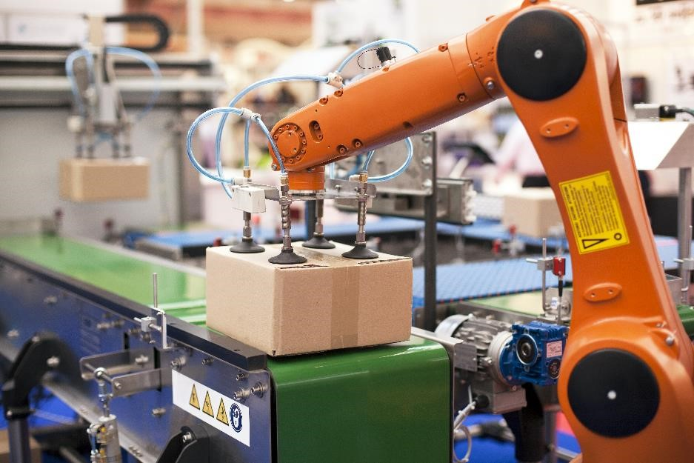
Improvements
Diversified datasets environments
Enhances model robustness and accuracy.
Refinement need for improved angle detection
Lighting optimization crucial for maintaining marker visibility.
ArUco marker configurations regulation of sizes & arrangements for improved detection.
Advanced technologies exploration of advanced cameras and image processing techniques.
16
Notes:
Discuss the results of the CAD designs testing.
Highlight the importance of marker placement and design.
Discuss the significance of end effector marker placement.

Slide 17
THE END Thank you for your attention
17

Slide 18
Appendix a
Elbow (Average)
Sensor | -44.90 | 22.90 | 8.00 | 0.00 | 3.30 | 0.20 | 12.10 | 30.10 | 48.00
Protractor | -91.40 | 21.60 | 45.70 | 68.50 | 1.70 | 65.60 | 44.40 | 16.60 | 91.80
Encoder | -90 | -67.5 | -45 | -22.5 | 0 | 22.5 | 45 | 67.5 | 90
Elbow (Standard Deviation P)
Sensor | 0.70 | 0.54 | 0.89 | 0.63 | 0.78 | 0.75 | 0.70 | 0.70 | 0.89
Protractor | 0.49 | 0.49 | 0.46 | 0.50 | 0.46 | 0.49 | 0.49 | 0.49 | 0.40
Encoder | 0 | 0 | 0 | 0 | 0 | 0 | 0 | 0 | 0

Slide 19
Appendix B
Shoulder (Average)
Sensor | 46.80 | 22.80 | 1.00 | 3.60 | 14.30 | 7.80 | 10.00 | 30.90 | 41.80
Protractor | 0.20 | 18.90 | 35.70 | 63.70 | 0.30 | 67.40 | 45.60 | 22.40 | 89.50
Encoder | 0.00 | 22.50 | 45.00 | 67.50 | 90.00 | 112.50 | 135.00 | 157.50 | 180.00
Shoulder (Standard Deviation P)
Sensor | 0.60 | 0.60 | 0.63 | 0.66 | 0.64 | 0.75 | 0.77 | 0.70 | 0.40
Protractor | 0.40 | 0.30 | 0.46 | 0.46 | 0.46 | 0.49 | 0.49 | 0.49 | 0.50
Encoder | 0.00 | 0.00 | 0.00 | 0.00 | 0.00 | 0.00 | 0.00 | 0.00 | 0.00

